Slide 1
HDT-4470: Automating Automation, Cheaply
Michael Freeman, Sr. Applications Development Analyst
mlfreeman@gmail.com
michael.freeman@bkfs.com
Andrew Detandt, Systems Manager
andy.detandt@bkfs.com

Slide 2
Session Overview
Who Are We
History
Hardware
Software
Lessons Learned
Questions

Slide 3

Who is BKFS?
Based in Jacksonville, FL
Formerly known as Lender Processing Services until 2014
Largest single provider of technology, services, data, and analytics to the U.S. mortgage industry.

Slide 4
History
2009
Recruited to help start automated testing team for the Servicing Technologies division.
Decided to use RFT after evaluating competition
Lab would have to run multiple versions of Windows and IE
XP + IE 7, XP + IE 8, Win 7 + IE8, Win 7 + IE9, etc.
Only viable option: virtual machines.

Slide 5
History
2010 – First lab: XenServer on 10 desktops
Free, worked, but with limits
Performance wasn't the best
Thin provisioning of VMs wasn't available
2011 – Second lab: VMware ESXi Free Edition – same machines
Thin provisioning enabled us to put more VMs in.
Free version could only be managed manually.
2011/2012 – Third lab: Archipel VM orchestrator + Fedora 15
Free, polished UI, but the UI was slow and the backend had issues
Gave us ideas for later though

Slide 6
How was all this managed?
Perl
More Perl
Manual Labor
Major tasks (e.g. new RFT version)
Deciding which scripts run on which machines
Is this painful?
Yes!

Slide 7
Better Way
Our initial vision was simple: "Automate Automation"
Try to automate as many of our tasks as we could so we could just keep coding.
We saw what you could do with cloud companies.
Cost and security restrictions ruled out actually using them.
Why didn't we use an existing open source VM package?
Complexity of setup
Automation doesn't need a lot of what they offer

Slide 8
The Present Lab
Multiple levels of labs
"Main" lab: 168 possible VMs up across 14 hosts
Hosts all have 32 GB RAM and SSDs (256/512 GB)
All automated testing for other groups goes on here
"Dev" labs
Older hardware (previous main-lab machines)
Team tests scripts on here before they go live
All lab virtual machines use standardized Windows images

Slide 9
Lab Software
Created In-House
Lab Manager
Logging Framework
RQM Bridge
Virtual Machine Manager
Not Created In House
RFT
RQM
Linux/QEMU/KVM/libvirtd
Windows

Slide 10
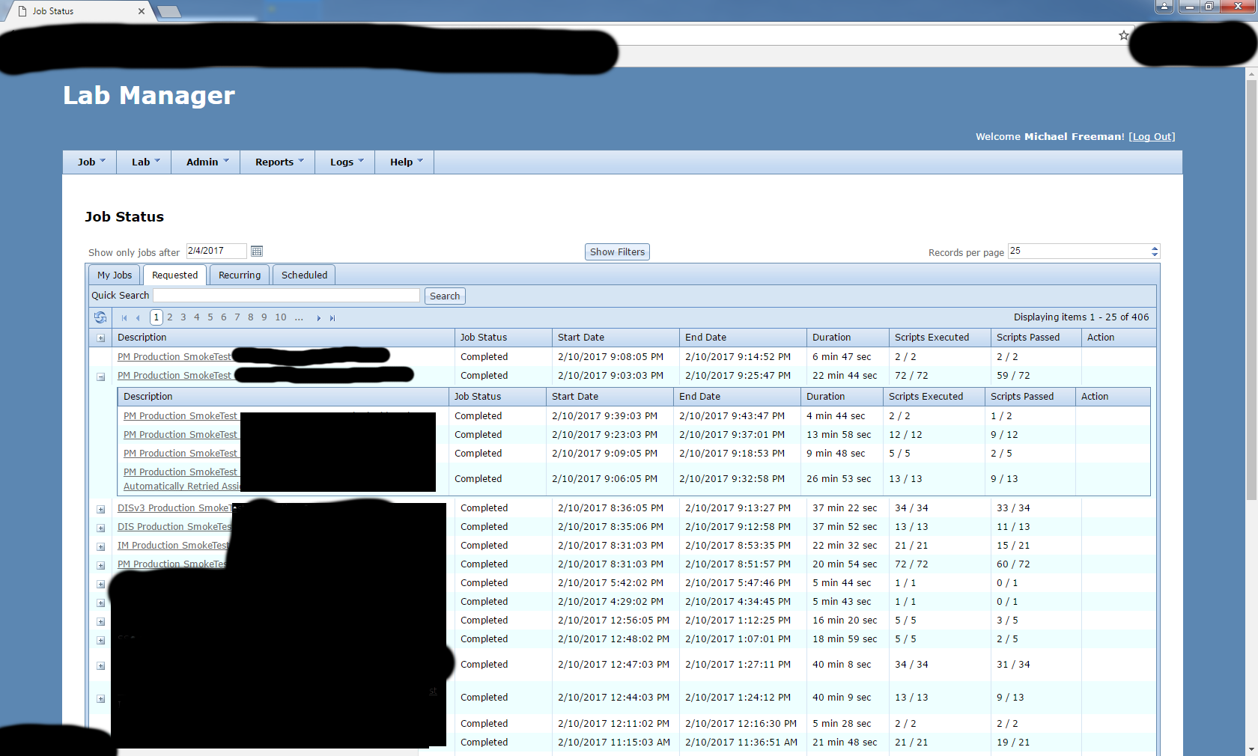
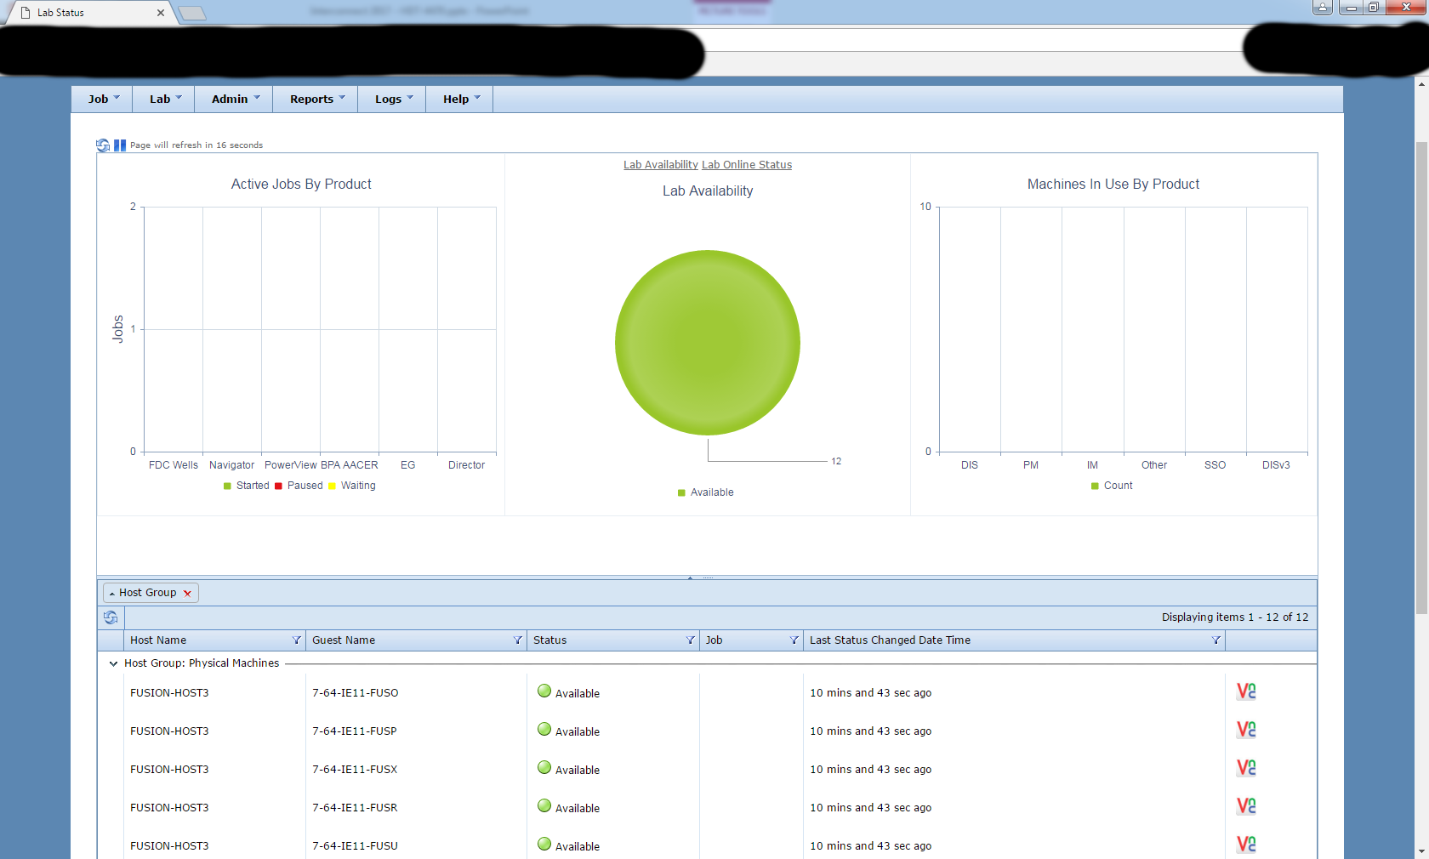
Lab Manager
Started on it in 2011/2012
First one of our current tools
Simple goal: Automate script execution
Perl scripts were limited
Required manual load balancing of scripts
Required coordination among team members

Slide 11
Lab Manager
We looked at RQM automation support but it was limited too
Can't share lab machine across multiple RQM projects
Have to manually connect to said machine and point it to other project
When we started, Test Automation Cells didn't exist in RQM yet.
You had to explicitly specify exactly which machine to send scripts to.

Slide 12
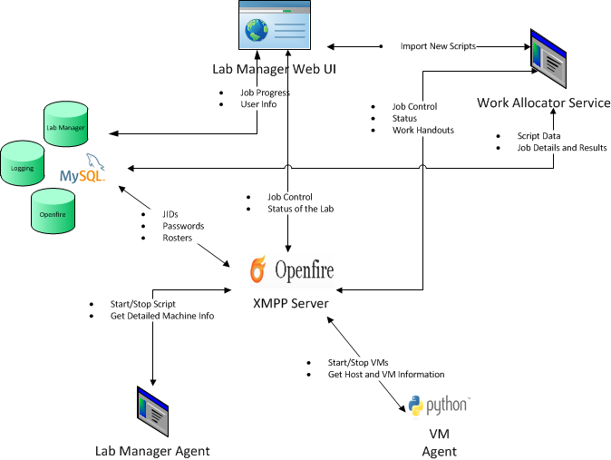
Lab Manager
Multi-tier system
Web UI
Service API
Backend Service
Agents on every VM and physical machine
Eclipse plugin
Uses XMPP as a service bus of sorts

Slide 13
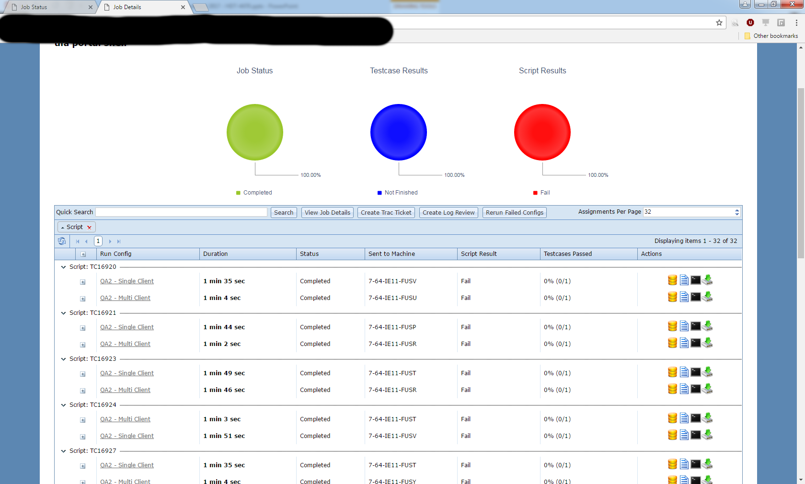
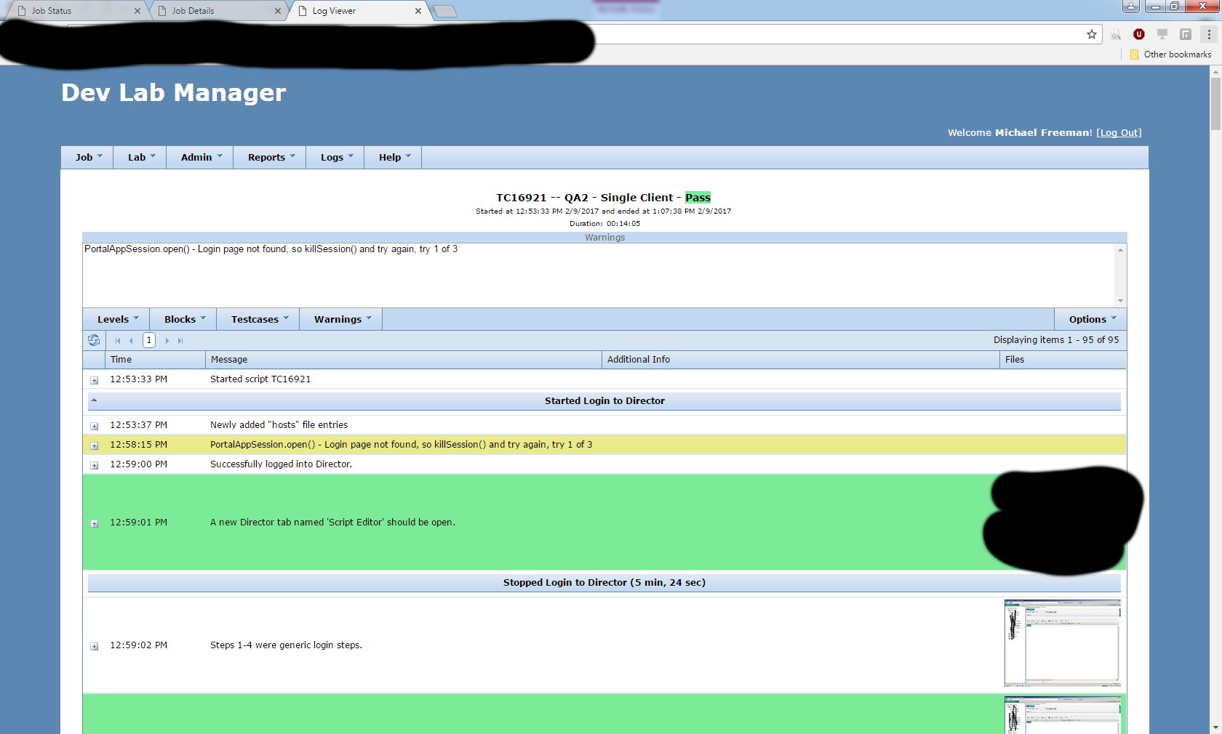
Lab Manager
Multiple execution requests can be submitted at the same time.
Even for different Windows/IE versions
System monitors lab and finds open spaces to run scripts
Turns on/off Windows VMs based on demand.
Common execution scenarios (e.g. regression for product X) can be saved for quick re-use.

Slide 14
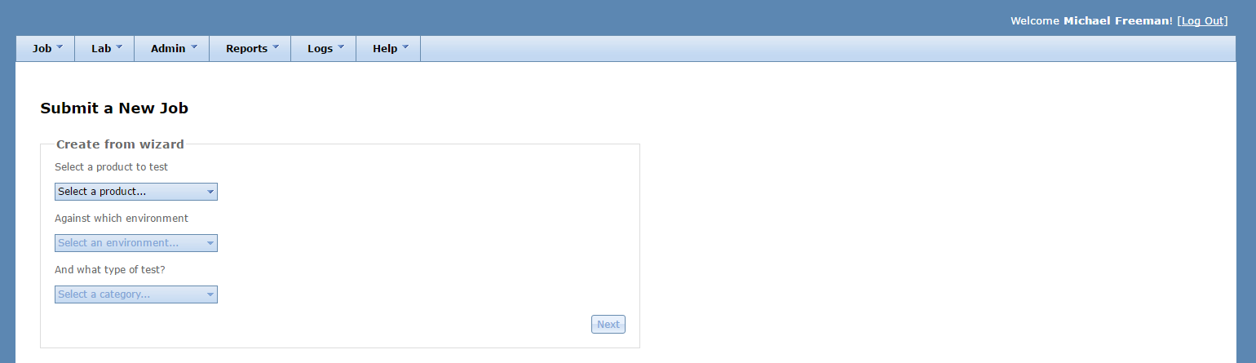
Lab Manager
E-mail notifications when work requests finish.
Service API allows tools such as UrbanCode Deploy to automatically request work
(e.g. Run smoke test automatically after build is deployed)

Slide 15
Lab Manager – Overall
Overall, everyone gets their work done faster.
Product | Type of Test | Execution Times |  | Time Saved
 |  | Last release w/out lab manager | First release with lab manager
A | Smoke | 36 minutes | 15 min 46 sec | 20 minutes
 | Regression | 2 hours, 48 minutes | 2 hours, 13 minutes and 15 seconds | 35 minutes
B | Smoke | 43 minutes | 19 minutes and 18 seconds | 24 minutes
 | Regression | 2 hours, 41 minutes | 1 hrs 19 min 2 sec | 1 hour, 22 minutes
Most importantly, automation scripts can be run and reviewed by other teams on their own.

Slide 16
Lab Manager – Logging Framework
As part of all this, we created a custom object-based logging API
We need more than just free-form text describing what happened.
Screenshots, uploaded/downloaded/generated files, test variables, etc
We output to multiple formats
2 forms of HTML, and one PDF layout now
Script writers are not allowed to think about what it looks like in the log
Structured objects force script writers provide a baseline level of detail
Free-form text APIs (e.g. log4j) can let people forget to include info
Logging DB currently holds 2+ years of data
850,000 script runs
45-50 million log entries
1 TB+ of distinct files (screenshots, etc) based on SHA-512 checksum

Slide 17
RQM Bridge
2014: Another automation team was merged into ours.
Previous QA groups working with them were used to the out of the box RQM process.
We wanted to keep as much of that as we could and still fit it in to our system.
I wrote a bridge to connect the two.

Slide 18
RQM Bridge
Java application
Powered by OSLC4J
Based on guide on jazz.net https://jazz.net/wiki/bin/view/Main/RQMTestAutomationAdapterAPI
RQM Bridge can dispatch work from multiple RQM projects to one Lab Manager and intelligently track everything.

Slide 19
RQM Bridge
RQM Server
Lab Manager
RQM Project
Lab Manager
RQM Bridge
RQM Project
Lab Manager
RQM Server
RQM Project

Slide 20
RQM Bridge
Bridged the two service APIs
Takes requests from RQM.
Translates them to Lab Manager requests
Monitors progress in Lab Manager, updating RQM
Gets final log from Lab Manager Logging DB.
Sends result and log back to RQM as RQM-friendly HTML
Requires us to use our own logging overlay framework in scripts.
Could not make it work anywhere near as well with RFT's default logging API / pipeline.

Slide 21
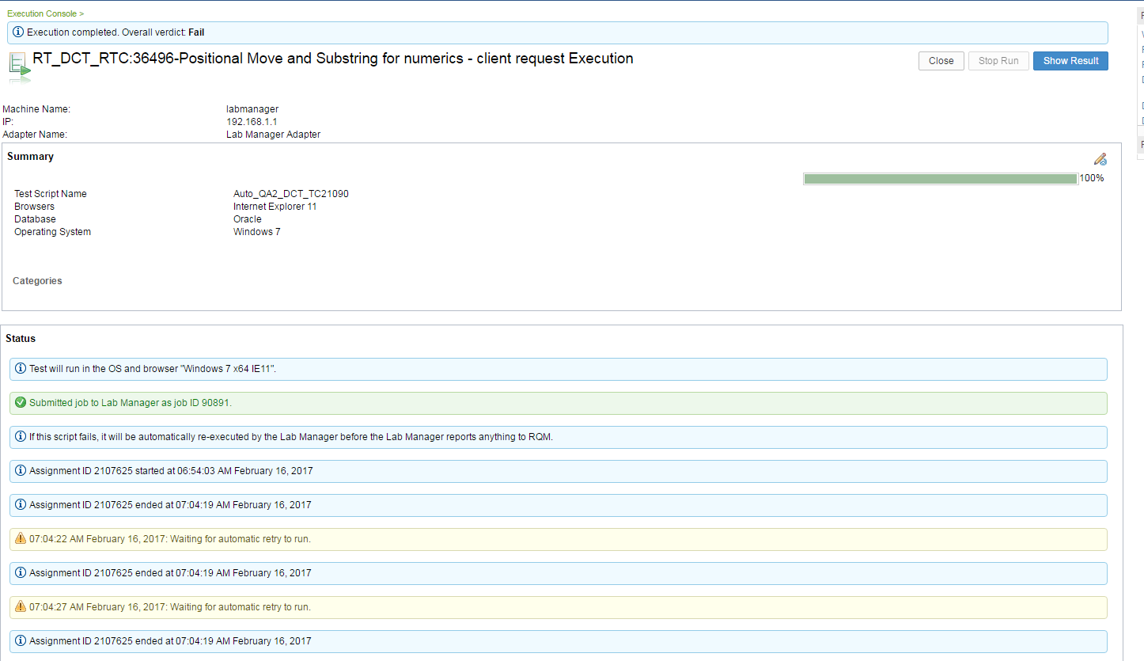
RQM Bridge

Slide 22
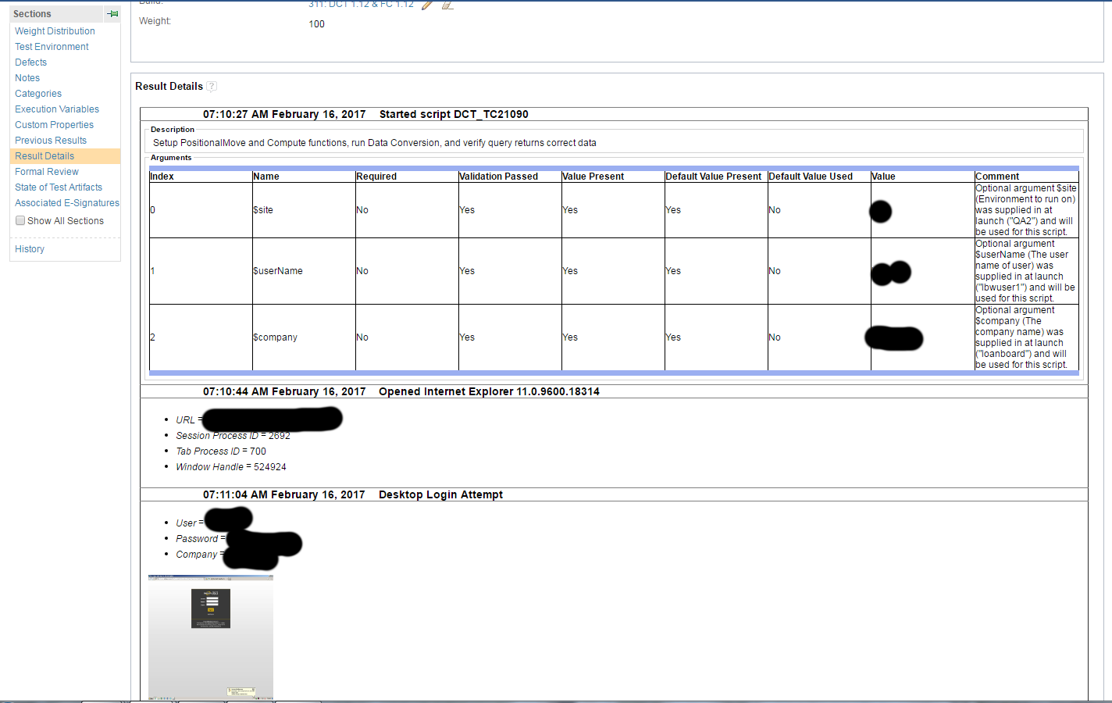
RQM Bridge

Slide 23
RQM Bridge - Surprises
Custom Test Automation Script Types don't allow you to have variable arguments from instance to instance.
Our scripts don't always take the exact same number of parameters.
We have pre-defined "run configurations" in Lab Manager.
Each one of our custom test automation script instances just points to one of those.
The "run configuration" is a combination of the script and a specific set of args for it.
The bridge had to be ready for connections to RQM being dropped a lot.
Log returned to RQM must be simple HTML but you can include screenshots.
RQM does *not* de-duplicate file attachments (e.g. screenshots)
An infinite loop accidentally filled up one of our RQM servers until I made the bridge do de-duplication on its end.

Slide 24
Virtual Machine Manager
Second major tool we created
Started life as part of Lab Manager
Pulled it out into a separate tool so we could offer a copy to another group
They use it to manage their dev environment VMs.
Currently, it shares/reuses the Linux agent from Lab Manager.
Provides a web front end for lower-level tasks that used to be restricted to trained team members running Perl scripts

Slide 25
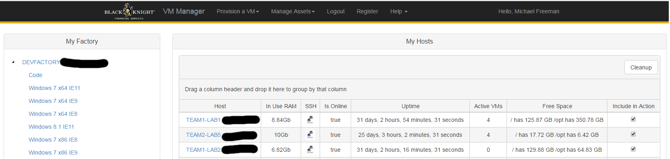
Virtual Machine Manager
Offers "infrastructure as a service" type capabilities
Start/stop VMs individually or in bulk
Monitor lab health (physical machine status, free space, etc)

Slide 26
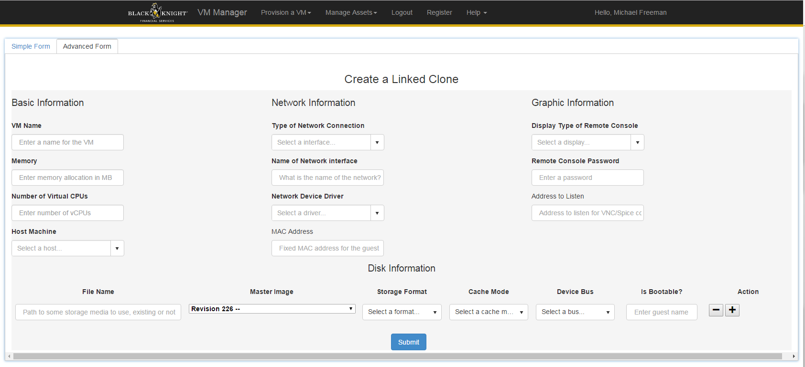
Virtual Machine Manager
Create/delete VMs on demand
Individually or in bulk

Slide 27
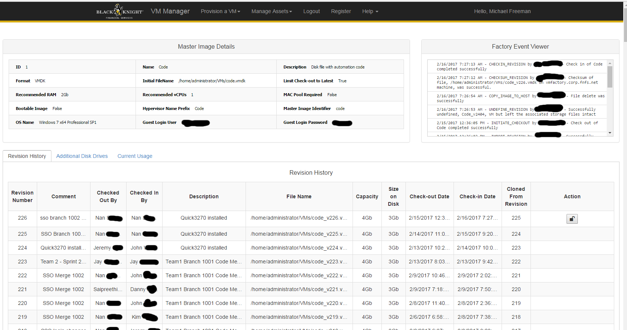
Virtual Machine Manager
Manage lab images (virtual disks)
Track/store multiple revisions of the same image, for easy deployment and rollback

Slide 28
Rational Functional Tester
I personally have been using it since 2007.
The ability to treat RFT's testMain() as if it were basically a regular Java main() function made a lot of what we do possible.
Other automation tools aren't so easy to drive programmatically.
It works well enough for our lab now.
90% of our applications under test are web apps.
Other technologies:
.NET full applications: 2
3270 terminal apps: 1
Java applets: 1
Silverlight applications: 1
Delphi 2010 applications: 1

Slide 29
Rational Functional Tester
Had to build a framework that worked inside it but could bypass or extend it for some cases
Logging (mentioned earlier)
Apps that needed to use MS UIAutomation underneath for testing
Silverlight
Delphi
Windows Dialogs (Open, Save As, Print, etc)
Shared not-under-test apps (e.g. Notepad++, Notepad, etc)
Database connectivity
Webservice connectivity
File IO (Excel, PDF, HTML parsing, CSV, ZIP, etc)

Slide 30
Linux
Lab machines use Ubuntu Linux 14.04 LTS
We install QEMU/KVM to provide the actual hypervisor for Windows VMs.
We use libvirtd as the thin layer between our own agent and the virtual machines on each host.
If you use boxes with solid state drives, the base Ubuntu OS layer can work basically out of the box with no real changes needed.

Slide 31
Linux
We can comfortably get about 3 VMs a core, before RFT slows down
We never let guest memory exceed 75% of the host's total
Hypervisors need 10-20% additional RAM per VM for their purposes
(e.g. a VM with 2 GB RAM will take 2.2-2.4 GB RAM on the host)
On a quad core box with 32 GB RAM, this gets 12 VMs with reasonable performance.
When rolling out new virtual disks to the lab, Windows will sometimes throw fits about product activation. RFT still works even if Windows is unactivated.

Slide 32
Lessons Learned
Why did we code so much ourselves?
Cost of commercial tools
Hassle of open source tools
Learning experience for the team
Junior developers who want to go on to "real" development roles
Provides something to break up the routine of scripting
On a team of 10+ it took well under 1 person's time-equivalent to develop this over the years.
Build everything in small modules.
You never know what you might realize you can create if you've created the right microservices.
Automation doesn't need all the shinier aspects of cloudy computing
Create, delete, start, stop, update disks…that's all you really need to do to your VMs.

Slide 33
Lessons Learned
A lab shared across products has proven to be a better value than creating separate labs for each product, even with the cost to create our in-house tools.
Execution is faster. Lab machines are never left unused if there's work to be run. Not every product has to shell out for a lab of its own.
Automation practices are kept to a global standard so they work on a standard VM.
When you have a shared lab, make sure to share the automation team.
We spend more time talking amongst ourselves about automation problems (e.g. unusual UI controls) than we do talking with product-specific people about AUT matters.
If we were split by products, automation developers would end up reinventing the wheel a decent amount of the time.

Slide 34
Lessons Learned
Every tool (e.g. RQM) has its surprises that you can't see until you dive in, so when evaluating one, always quadruple any estimates you initially come up with.
The forums on jazz.net were helpful when writing the RQM bridge.

Slide 35
Conclusion
In short, sophisticated test automation capabilities are much easier and cheaper to obtain than you might think!
Hopefully, my notes will help you on your journey towards test automation excellence.

Slide 36
Questions?

Slide 37
Thank you for attending my talk today.
The slides are on GitHub
http://github.com/mlfreeman2

